Slide 1
MARKETING CAMPAIGN ANALYSIS

Slide 2
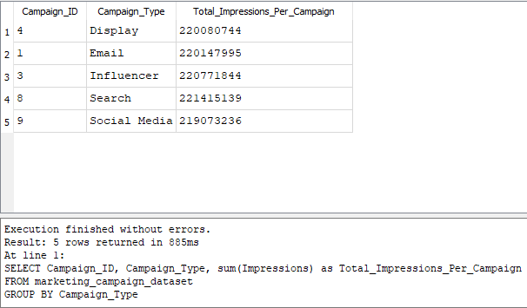
OBJECTIVES
Analyzing the dataset through various visualization and aggregation techniques, to derive meaningful insights that will help the company make informed decisions on inventory management, sales strategies, and marketing campaigns, ultimately improving overall product performance.
INSIGHTS
From our table, we can see the total impressions for each campaign, shows Search campaign generates more impressions than the other campaigns, with influencers campaign also performing well.
We need to focus on how to improve our social media campaign impressions as well as other campaigns.

Slide 3
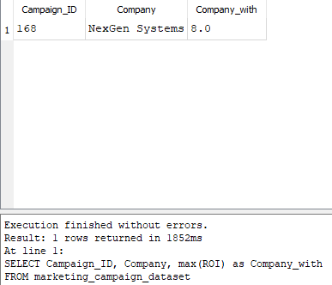
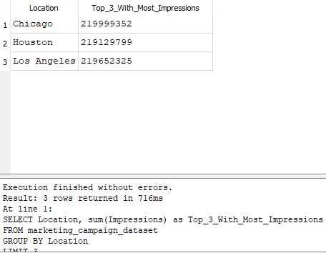
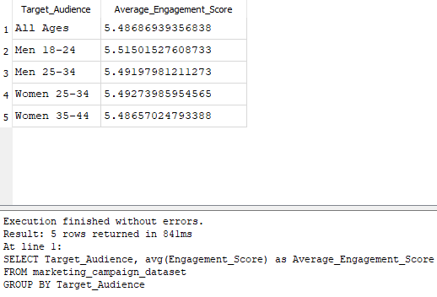
The first table shows company with the highest ROI, NexGen systems generates more profit from the campaigns than other companies.
Second tables shows top 3 locations with the most impressions, we see Chicago leading with the most impression and Houston and Los Angeles follow closely. We need to look closely on how to improve impressions in these locations as well as boost impressions in other locations.
The third table shows average engagement score from each age group, Men from 18-24 seem to engage more with the campaigns ,as well as women from 25-34, we need find out why the older ages don’t engage more and improve in that aspect while finding other ways to improve the younger engagements even higher.

Slide 4
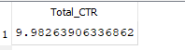
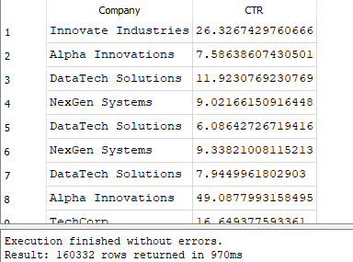
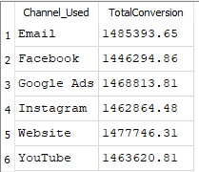
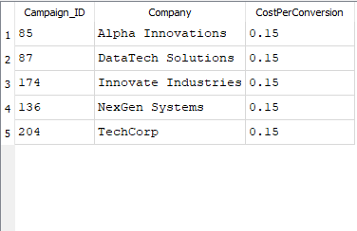
Table 1 shows the total CTR
Table 2 shows the most effective campaign with the companies with the highest conversion rate.
Table 3 shows CTR for each campaign that performs above the 5% threshold ,we can see that out of 20k campaign, 16k performs above the threshold which shows great sign with room for improvements
Table 4 shows the channel with the most conversions , email performs better than the other channels but are very close to each other, with only small differences between them. This could imply that all channels are performing similarly, with minor variations.

